Slide 1
Exercise 4

Slide 2
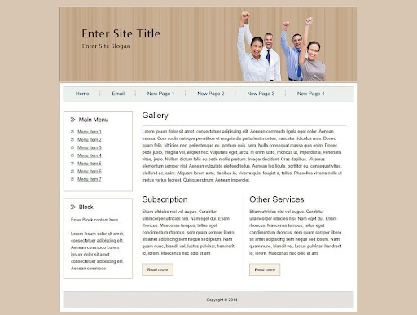
Define the component on this template
Footer component
Footer

Slide 3
TODO: Define and draw components
Header
Draw Header
image
Title
menu
menu
menu
menu
menu
Menu component
Draw menu component

Slide 4
Body-component
Title
Paragraph
paragraph
Paragraph
Main menu component
Block component
Title
Title
Button
Button
Letter
Letter

